Slide 1
ABB Ability™ Smart Sensor
ABB Motors and generators
Firmware upgrade – how to do it with a mobile phone

Slide 2
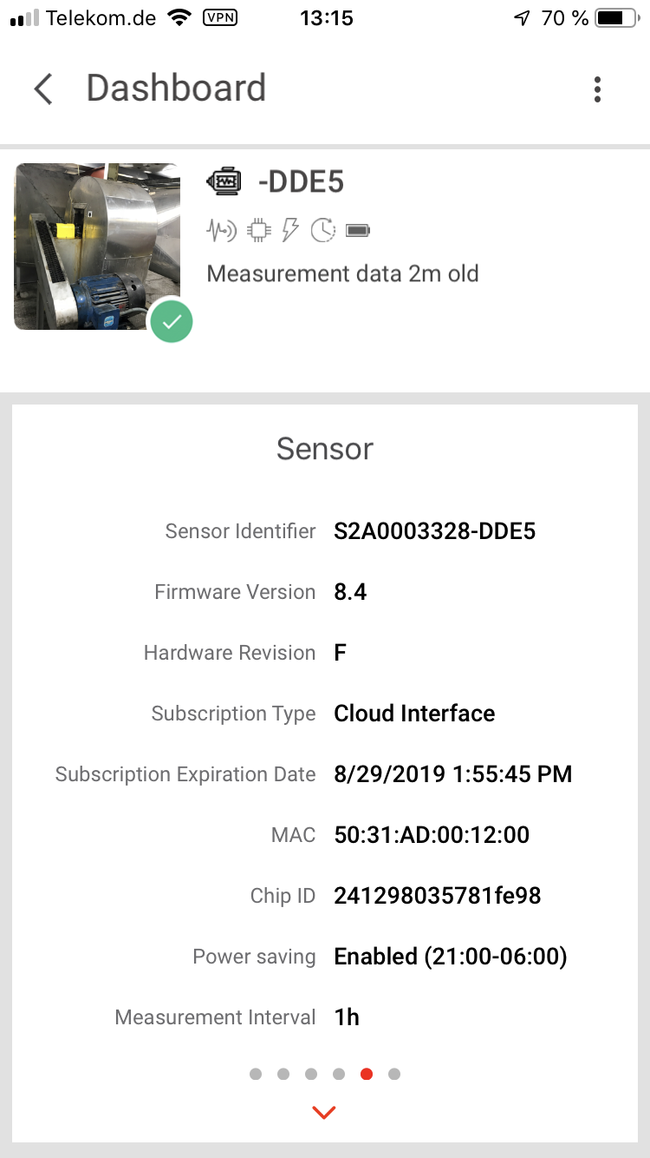
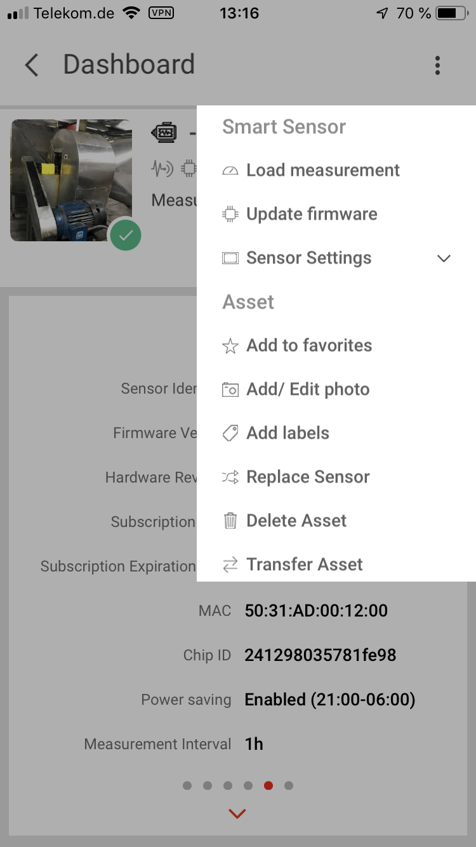
ABB Ability™ Smart Sensor
Upgrading the firmware (FW) with a smart phone
Only when new firmware is available the app show the “microchip” icon in the status bar.
The current firmware version is shown on the “Sensor Card” in the app (and also in the web portal)
Only when new firmware is available there is a item called “Update firmware” in the asset menu
the „microchip“ icon
means new firmware
is available

Slide 3
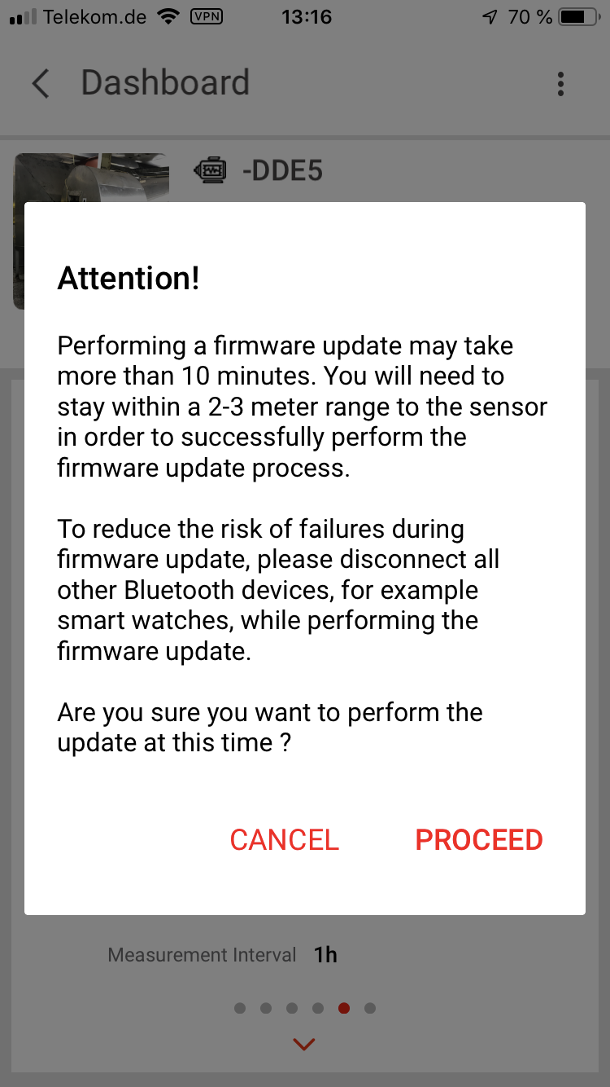
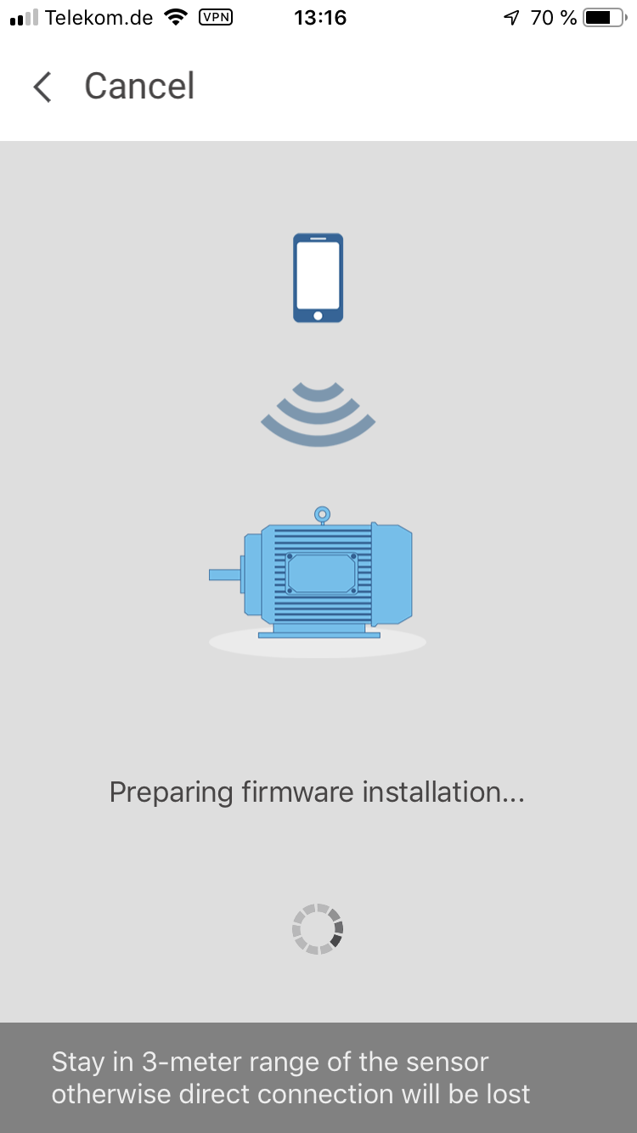
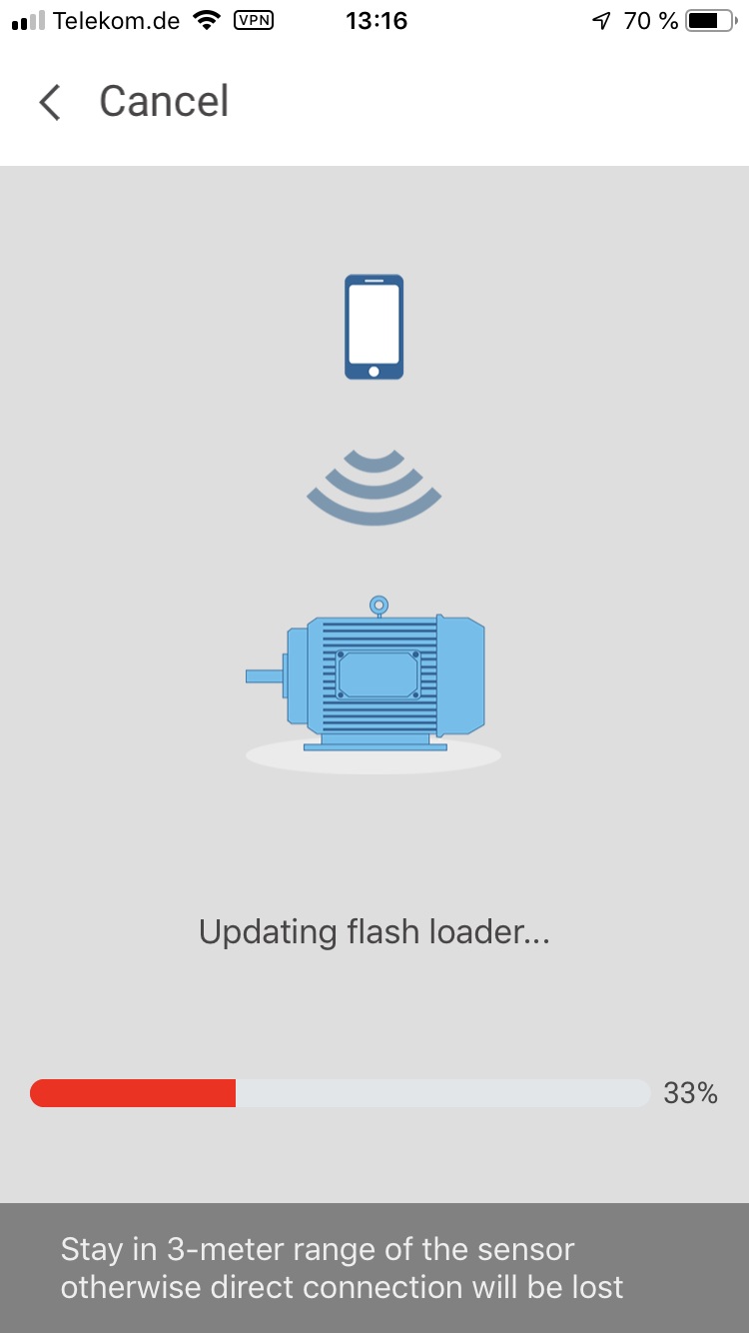
ABB Ability™ Smart Sensor
Upgrading the firmware with a smart phone
Confirm that you want to proceed after selecting “Update firmware in the menu
Leave your phone close to the sensor throughout the process
The update goes through several steps, including uploading the any new measurements that way be in the memory of the sensor
The flash loader is not the firmware, it is a small program that supports the process.

Slide 4
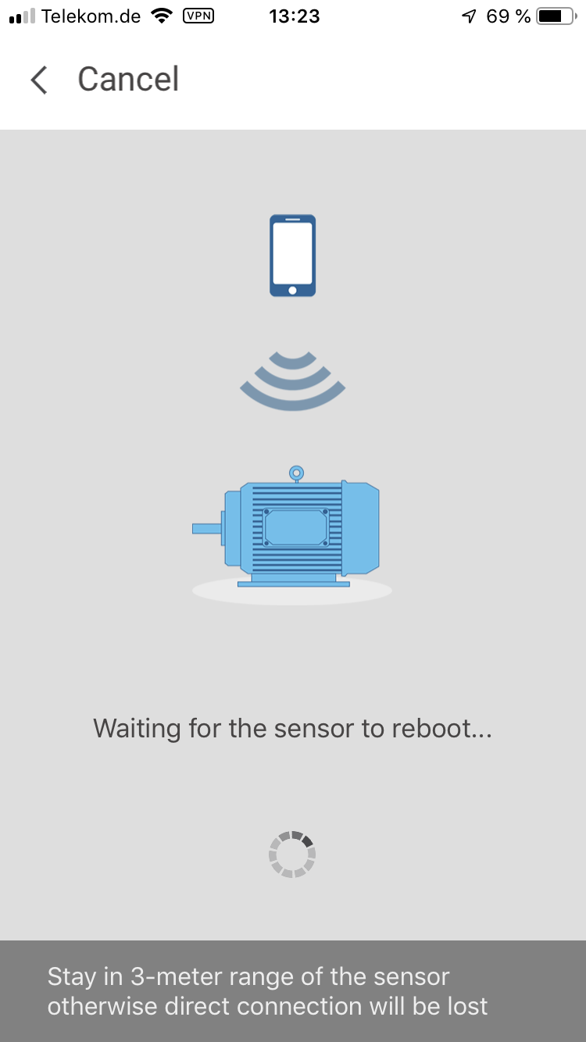
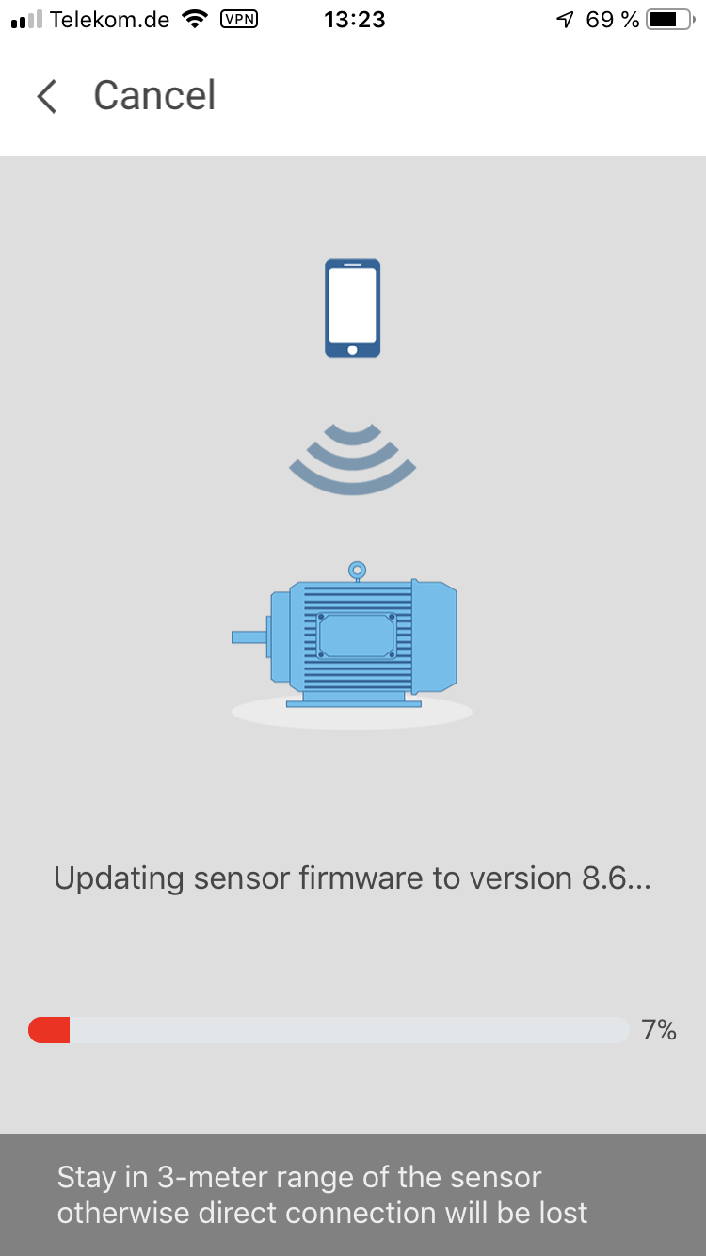
ABB Ability™ Smart Sensor
Upgrading the firmware with a smart phone

Slide 5
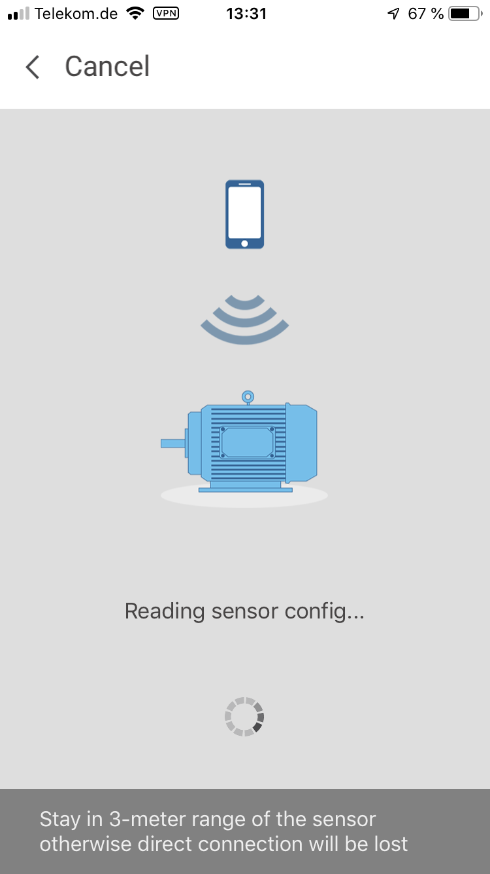
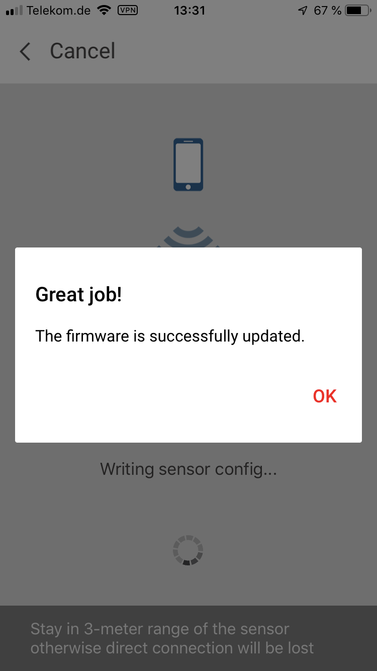
ABB Ability™ Smart Sensor
Upgrading the firmware with a smart phone
After installing the new firmware there are still a few steps
The app confirms if the update was successful

Slide 6
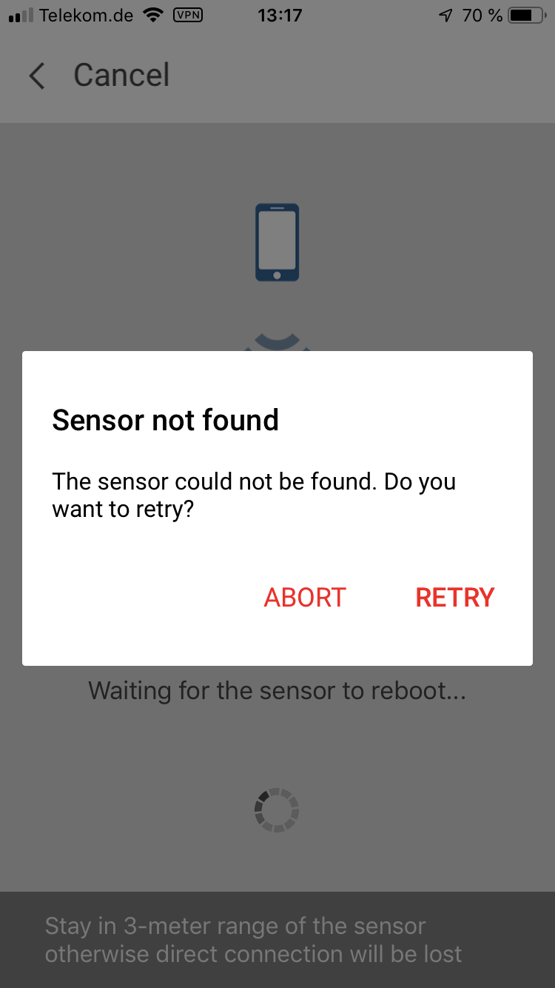
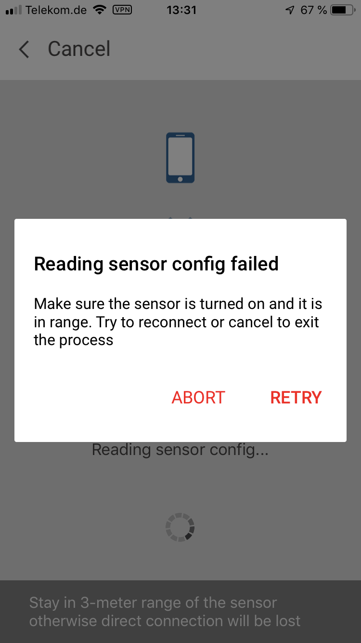
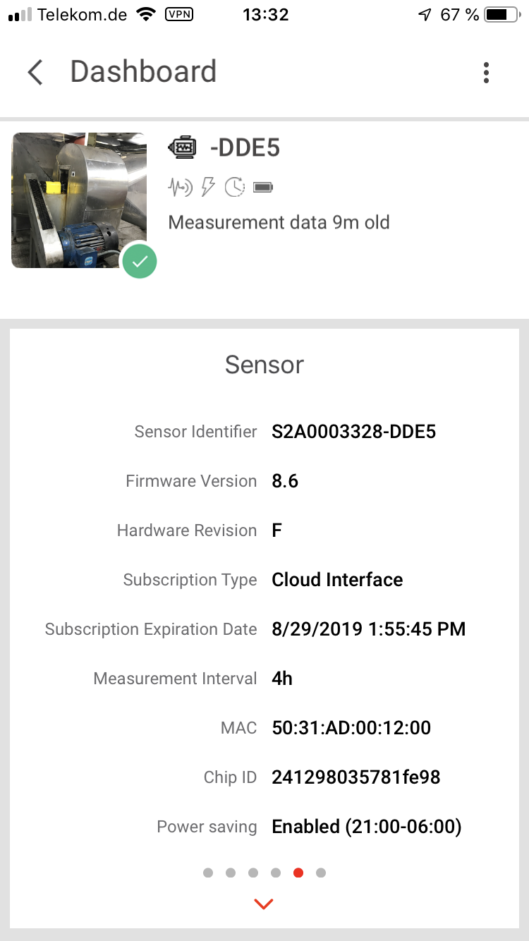
ABB Ability™ Smart Sensor
Upgrading the firmware with a smart phone
If anything goes wrong you will get error messages.
For example, this could happen if the phone is moved away from the sensor during the update process, or if another Bluetooth device interferes. Just try again, it is not a problem.
In the end, you can see the new firmware version in the app.

Slide 7
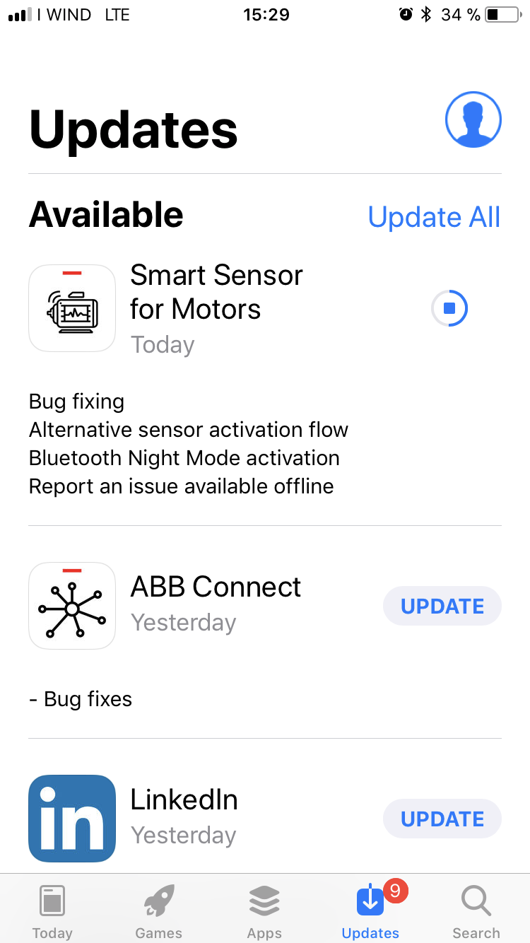
ABB Ability™ Smart Sensor
Don't forget to update your app
Normally new functionality provided by new firmware is only available if the app is updated to the latest version.
Check App store and Google play regularly.

