Slide 1
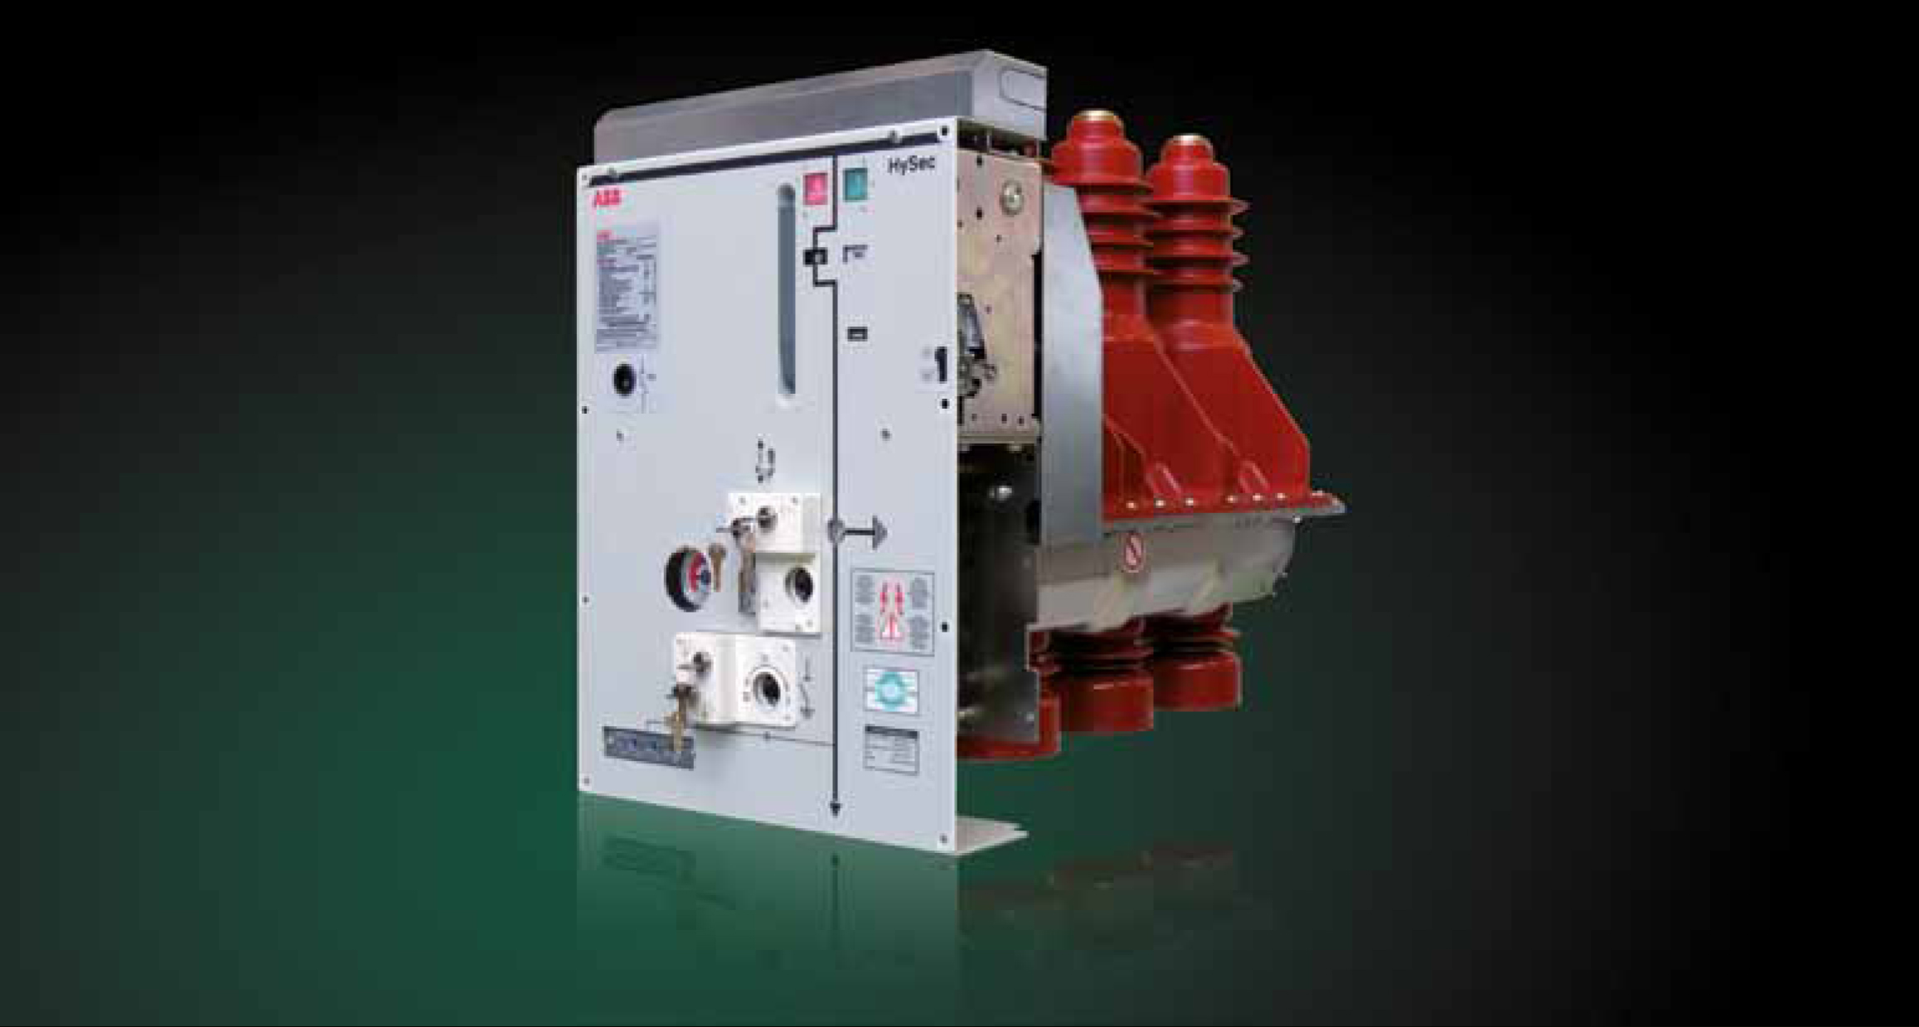
HySec
PPMV – Product Management
Multi-function apparatus for secondary distribution
Notes:
Welcome to the e-learning module on HySec: multi-function apparatus for secondary distribution.

Slide 2
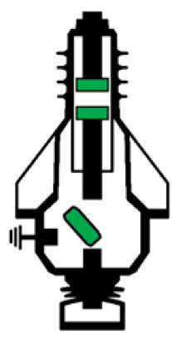
HySec
All-in-one
Upper terminal
Vacuum interrupter Breaks and makes the load
SF6 line disconnector
Insulate busbar from cables
SF6 earthing switch Grounds cable side
Lower terminal
Capacitive dividers intergrated
Notes:
Audioscript: HySec connections are made through an upper terminal and a lower terminal. The lower terminal is composed by epoxy resin bushing with integrated capacitive dividers.
Audioscript_1: The vacuum interrupter is located in the upper part of the apparatus to break and make the load and the short circuits.
Audioscript_2: The line disconnector and the earthing switch are located in the lower part and insulated with SF6. The line disconnector is used to isolate busbar side from cable side, while the earthing switch is used to ground the cables side.
Audioscript_3: This combination of functions makes HySec an all-in-one apparatus.

Slide 3
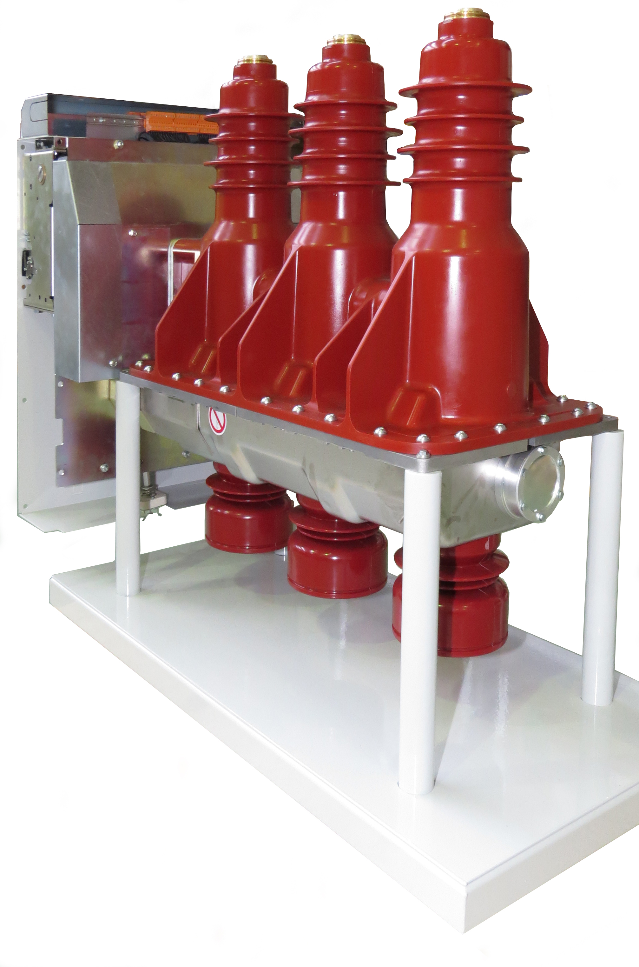
HySec
Compact and safe structure
Upper part in epoxy resin and filled with SF6:
compact design
long-term protection against external environment
Sealed for life: 30 years
Lower part in stainless steel
Metallic partition (PM) between busbar and cable compartments
Safety for operators during maintenance activities
Safety valve for release of accidental gas overpressure on the rear
Lower bushings with integrated capacitive dividers:
Direct cable connection
Notes:
Audioscript: The upper shell of HySec is made of epoxy resin sealed for life with SF6 to provide a compact design and to provide long-term protection against external environment.
Audioscript_1: The lower shell is made of stainless steel to provide metallic partition between busbar and cable compartments which results in improved safety for operators performing maintenance on the panel.
Audioscript_2: The lower shell presents a safety valve on the rear part, which releases SF6 gas in case of accidental overpressure opposite to the front of the panel.
Audioscript_3: The combination of epoxy resin together with stainless steel makes HySec structure compact and safe.

Slide 4
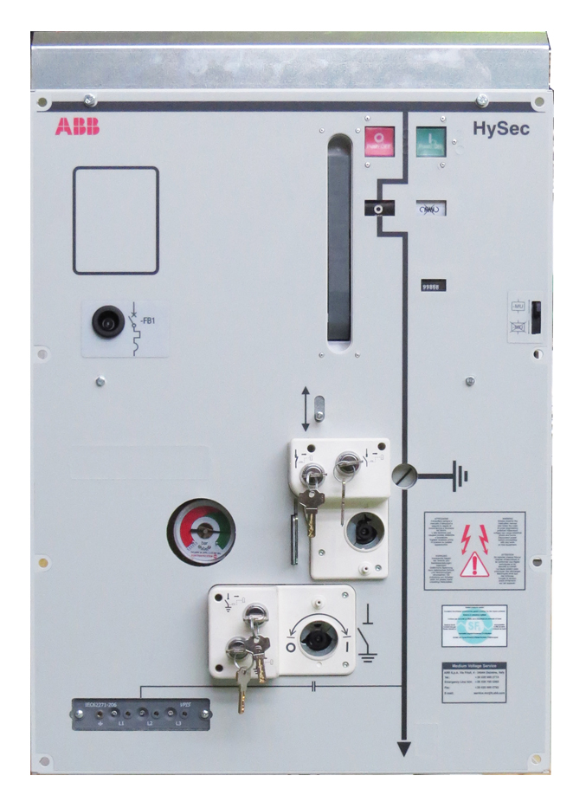
HySec
Reliable actuators
Interruptive part actuator
Mechanical trip-free actuator (EL type)
Local operations: lever + pushbuttons
Remote operations: motor + shunt releases
Disconnector and earthing switch actuator
Single spring mechanical actuator
Actuation speed independent from the operator
Separate operating seats for line and earth operations
Notes:
Audioscript: Looking closer to HySec front cover, the upper part is where the actuator of the vacuum interrupter is located. It is a mechanical trip-free actuator (called EL type) which allows both local and remote operations.
Audioscript_1: Local operations are allowed thanks to a lever to charge the closing spring and pushbuttons to close and open the breaker. Remote operations are allowed thanks to closing spring charging motor and close and open shunt releases.
Audioscript_2: The lower part of the front cover is where the actuator of the SF6 line disconnector and earthing switch is located. It is a single spring mechanical actuator (dead-point type). The actuation is performed by a lever and its speed is independent from the operator. There are two separate operating seats for line and earth operations for safety reason.

Slide 5
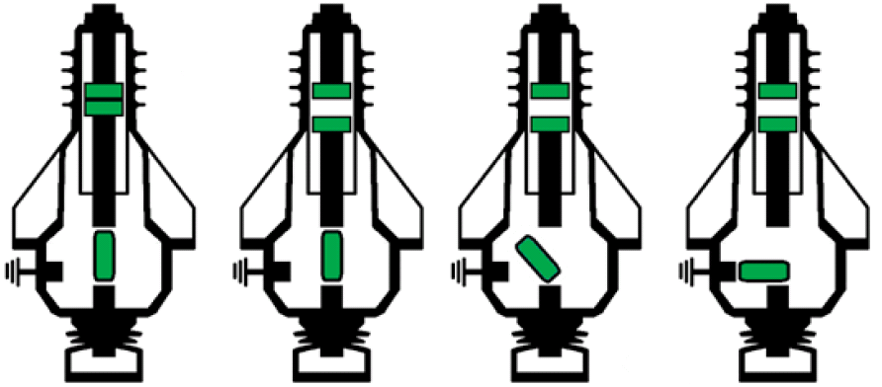
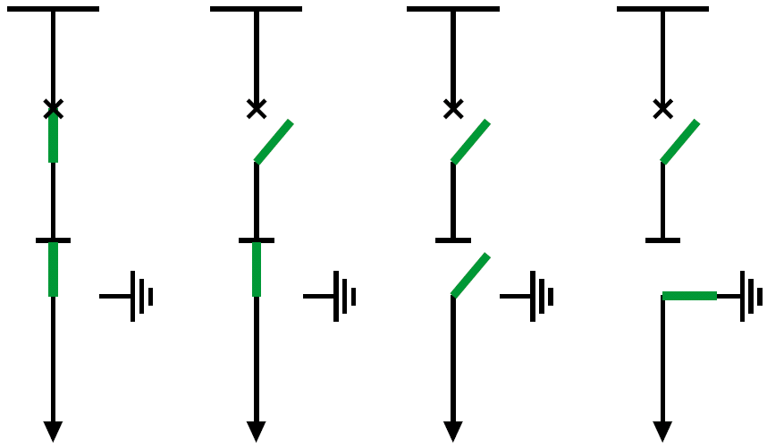
HySec
Mechanical interlocks for safety
(1)
(2)
(3)
(4)
Circuit breaker - Line disconnector
It is possible to close the breaker only if the disconnector is closed (1-2)
It is possible to open the disconnector only if the breaker is open (2-3)
Line disconnector - Earthing switch
It is possible to close the earthing switch only if the disconnector is open (3-4)
Earthing switch – Panel door
It is possible to open the door only if the earthing switch is closed
Closed
Open
Isolated
Earthed
Notes:
Audioscript: Several mechanical interlocks are integrated in HySec in order to prevent unsafe operations. The operating sequence can only follow the positions from 1 to 4 and from 4 to 1, without skipping anyone of them.
Audioscript_1: In particular, thanks to the interlock between the circuit breaker and the line disconnector, it is possible to close the breaker only if the disconnector is closed and it is possible to open the disconnector only if the breaker is open.
Audioscript_2: Additionally, thanks to the interlock between the line disconnector and the earthing switch, It is possible to close the earthing switch only if the disconnector is open.
Audioscript_3: Finally, thanks to the interlock between the earthing switch and the panel door, it is possible to open the door only if the earthing switch is closed.

Slide 6
HySec
Wide range of accessories
Circuit breaker
- Shunt opening release
- Shunt closing release
- Motor closing spring charger
- Undervoltage release
- Closing spring charged/discharged contact
-Opening and closing pushbottons protections
Line Disconnector
- Auxiliary contacts 4NC/4NO
- Key locks
- VPIS
- Manometer or pressure switch
Earthing switch
- Auxiliary contacts 4NC/4NO
- Key locks
Notes:
Audioscript: HySec has the possibility to be equipped with a wide range of accessories, both for the circuit breaker part and the disconnector and earthing switch part.

Slide 7
HySec
Safety, Compactness, Simplicity
Safety
- Metallic partition thanks to lower part in stainless steel - Mechanical interlocks to prevent unsafe operations - Safety valve on the rear for releasing gas overpressure - Separate operating seats for line and earth
Compactness
- Multi-function apparatus - Can fit 500mm wide panels - No need for cross-beam with insulators thanks to integrated capacitive dividers
Simplicity
- All-in-one apparatus - Easy operation and maintenance - Cable connections directly on apparatus thanks to integrated capacitive dividers

Slide 8
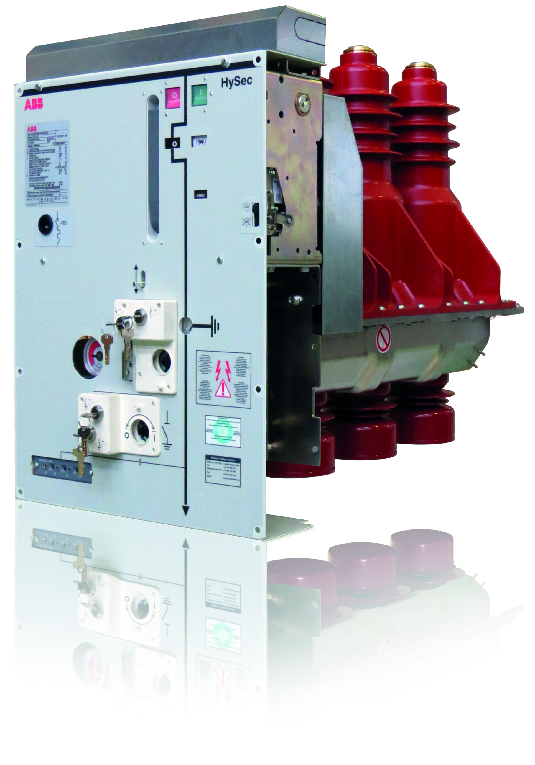
HySec
Multi-function apparatus
Apparatus integrating:
Vacuum circuit breaker
SF6 Line disconnector
SF6 Earthing switch on cable side
Command able to do fast operation cycle: O-0.3s-CO-15s-CO
Rated Voltage | up to 24 kV
Rated Current | up to 630 A
Breaking capacity | up to 16 kA (1s)
Mechanical class | M2
Electrical classes | E2, C2
Notes:
Audioscript: HySec is the first ABB multifunction apparatus integrating the functions of vacuum circuit breaker, SF6 line disconnector and SF6 earthing switch.
Audioscript_1: Its rated voltage is up to 24 kV, while its rated current is up to 600 A. Its breaking capacity is up to 16 kA, which is also its short time current withstand capability for 1 second.
Audioscript_2: HySec is able to perform 10.000 mechanical close-open operations. Its electrical life is classified as E2 and, up to 400 A, C2 for back to back capacitor switching.
Audioscript_3: HySec is also able to perform the fast operation cycle.

