Slide 1
Across the entire value chain
Services LPCP-July-2015
ABB, your partner for Services

Slide 2
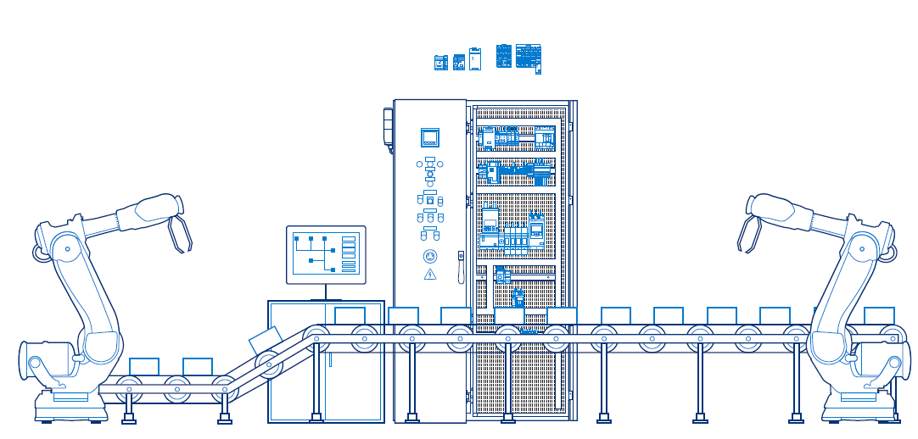
ABB takes care of your installations and systems, we provide responsive, proactive and predictive maintenance services
ABB’s service offering improves safety in your organization and prevents personnel injuries and material accidents
Our services improve operational efficiency and performance
of your systems and equipment across the complete lifecycle

Slide 3
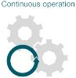
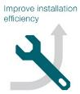
Whatever your priorities and needs are you can rely on ABB for the service solution
Benefit 1
Safety in your organization prevents personnel injuries and material accidents
We focus on safety to preserve your personnel from injuries and your installation from accidents
Benefit 2
Continuity of service, avoiding costly shut-down is vital for your installations
We optimize availability and efficiency of devices and systems, to keep them running longer
Benefit 3
Your assets constitute an investment of several decades and is worth of hundreds of billions.
Maintenance need increases due to ageing of your installations.
We improve the profitability of your assets and production plants, through our experience and our know-how
Responsive, proactive and predictive maintenance services

Slide 4
ABB knows how to protect your assets We protect, maintain and repair
Safety & Protection
Safety in your organization protects your personnel from injuries and ensures longer lifetime of the installed equipment
We optimize availability and efficiency of devices and systems to keep them running longer keeping the ageing of installation in mind
Maintenance
We develop sustainable solutions to lower environmental impact while making sure that our service solutions will help you avoid costly shut-downs
We develop
Continuous operation
We improve the profitability of your assets and production plants through our experience and our know how
Productivity
We take concrete commitments through reliable solutions and contracts

Slide 5
Whatever your needs are … We have the solution to keep your business running
Operational efficiency
Improve safety, availability and reliability of production processes
Engineering and consulting
Maintenance
Training
Extensions, upgrades and retrofits
Improve equipment reliability
Proactive, predictive and preventive maintenance services
Extensions, upgrades and retrofits
End of life services
Life cycle management
Maximize equipment availability
Repairs
Spares and consumables
Replacement
Service agreements
Rapid response
Advanced services for solutions to optimize efficiency in the long term
Second level
Engineering and consulting
Extensions, upgrades and retrofits
End of life services
Performance improvement
We keep you competitive

Slide 6
Operational efficiency
ABB optimizes efficiency of equipment and systems
Assistance in identifying how to improve safety, maintainability, availability and reliability of production processes.
Efficient operational condition keeping the production running and restoring machines and systems. Industry-specific advanced services and IT tools for process efficiency.
Extensions, upgrades, retrofits to ensure efficient operation, or applying new solutions and technology.
Service agreements to minimize production interruptions
Operational efficiency
Engineering and consulting
Maintenance
Advanced services
Extensions, upgrades and retrofits
Training
Service agreements
Reliability and efficiency optimization help to increase installation productivity

Slide 7
Life cycle management
ABB has solutions to preserve your assets longer
Diagnosis and lifecycle assessments to meet the maximum performance
Equipment reliability improvement through proactive, predictive and preventive maintenance services
Equipment and systems life extension by upgrades, retrofits and evolution through planning and execution
Service agreements including lifecycle services to keep equipment and assets in full working condition, updated to use the latest technology
Life cycle management
Installation and commissioning
Maintenance
Extensions, upgrades and retrofits
Replacement
Training
Spares and consumables
End of life services
Service agreements
Powerful tools and ABB knowledge base help to extend the lifecycle of your equipment.

Slide 8
Rapid response
ABB provides fast and flexible service response
Service operation during emergencies or planned production breaks
Delivery of spares and consumables
Equipment and system training services for personnel
Troubleshooting identification, root causes of equipment failures, analyses and estimation of appropriate time for its replacing or implementing the replacement
Tailored service agreements guarantee quick help in all situations
Rapid response
Installation and commissioning
Maintenance
Extensions, upgrades and retrofits
Replacement
Training
Spares and consumables
End of life services
Service agreements
Fast and flexible service response to maximize your equipment availability.

Slide 9
Performance improvement
ABB is your strategic partner in improving productivity
Advanced services for sophisticated solutions to optimize overall efficiency of assets (OEE).
Skilled professionals, engineering and consulting services to improve operational efficiency in the long term.
Extensions, upgrades and retrofits.
Service agreements with long-term production efficiency plan and key performance indicators to ensure OEE improvements, competitiveness and profitability.
Performance improvement
Advanced services
Engineering and consulting
Extensions, upgrades and retrofits
End of life services
Service agreements
Ensure overall and long-term improvement competitiveness and profitability

Slide 10
Service contracts
Notes:
10
10

Slide 11
Your business requires services contracts? Ready-to-use services packages and tailor-made contracts are designed to fit your needs
Strategic partnerships
Consulting
Responsive services
Advanced services
Value creating services
Break and fix
Technical support
Productivity and energy efficiency solutions
Installation and commissioning
Co-develop solutions
Value-based offerings
Spare parts
Training
Lifecycle management
Optimization solutions
Evolution programs
Process improvement
Software services
Remote solutions

Slide 12
Your business requires tailor-made services?
ABB can design your service contracts with Power Care
With Power Care contracts, you combine modules fitting the best to your needs
Level 1
Level 2
Level 3
Areas
Skills Development Services
Product Training List
Product Training
Application Training
Coaching Services
Emergency Maintenance Services
Single Point of Contact
Technical Support 24/7 with agreed response time
Call-out Support with agreed response time
Emergency Spare Parts Assessment and Purchasing
Diagnosis & Condition Assessment
Technical preliminary Survey
Asset and Risk Assessment
Local Asset Monitoring
Remote Asset Monitoring
Self-Maintenance Services
Documentation of Installed Base & Cycle Status Report
Manuals and instructions On-line
On-Line Support for Self-maintenance
File Storage
Delivered maintenance Services
Technical Assessment on Yearly Basis
Report
Stand Alone Product Maintenance
Product Advanced Maintenance
Switchgear
Maintenance

Slide 13
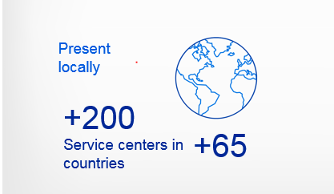
Because we understand that every second counts, Our services are globally developed and locally executed
Wherever you are, you have always someone close to you with offerings for the entire lifecycle
Notes:
Source: ABB Annual Report 2013:
In 2013 Life-cycle services continued to be strong and recorded a moderate growth and we continued to refocus our portfolio towards higher value-added activities. Service revenues continued to grow but represented the same share of total division revenues as in 2012.
Revenues from service transactions are recognized as services are performed. For long-term service contracts, revenues
are recognized on a straight-line basis over the term of the contract or, if the performance pattern is other than straightline,
as the services are provided. Service revenues reflect revenues earned from the Company’s activities in providing
services to customers primarily subsequent to the sale and delivery of a product or complete system. Such revenues
consist of maintenance-type contracts, field service activities that include personnel and accompanying spare parts, and
installation and commissioning of products as a stand-alone service or as part of a service contract.

